Slide 1

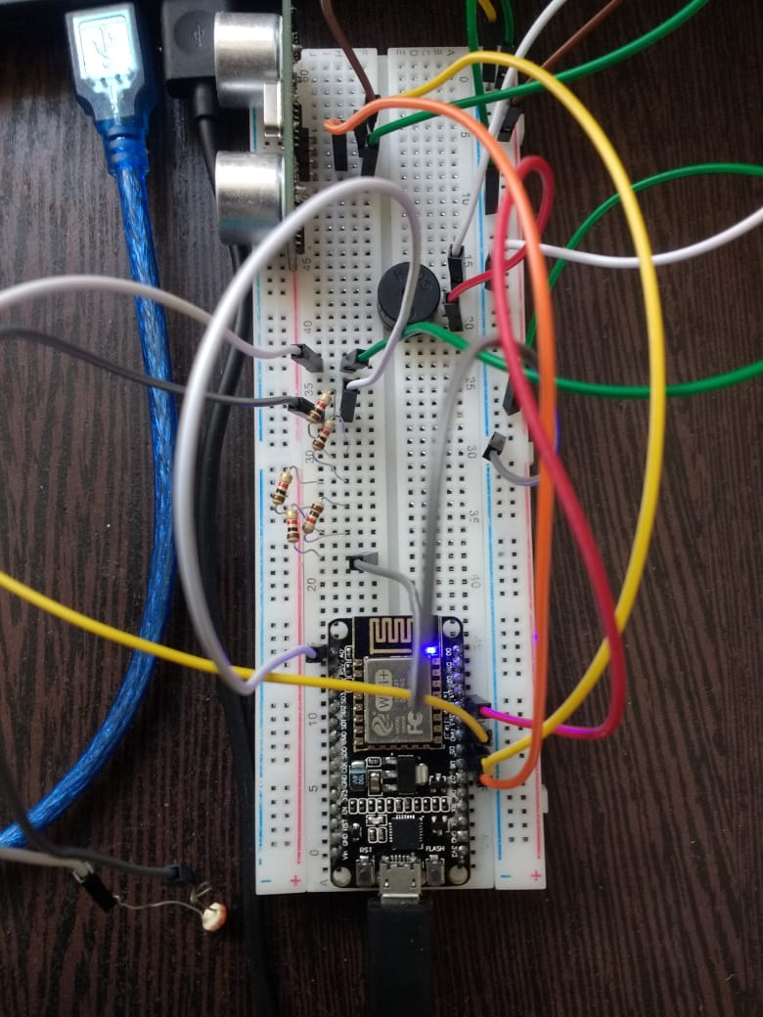
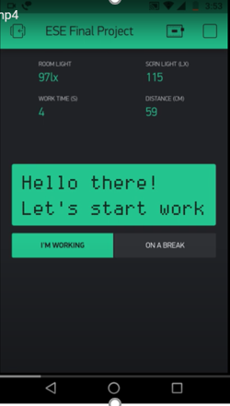
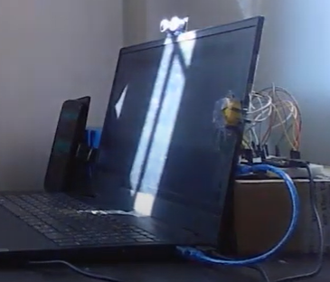
ESE 111 Final Project Group 13
Dr. Screen
This handy doctor will make sure you’re using your screen right!
Racheal and Vaishnavi
Place your screenshot here

Slide 2










The Virtual Workplace
The shift to online work and learning environments has dramatically increased screen usage
With this comes a greater risk of health issues associated to continuous exposure to blue light
Notes:
Racheal

Slide 3

Dr. Screen - The Virtual Doctor
Your doctor is here! This handy device ensures users’ screen usage is healthy as per generally health practices for online screen usage.
Healthy screen usage is measured through
Distance between user’s eye level and screen
Time spent working in one stretch of time
Relative light intensity of screen and environment
Notes:
Racheal

Slide 4


Parameters
Component | I/O/ Device
Ping Sensor | Input
Photoresistor | Input
Virtual Switch | Device
Buzzer | Output
Virtual LCD | Output
Time spent working in one stretch
Prescription: It’s recommended the user takes a break every 20 minutes
Modification: Set a threshold for working as 2 minutes. Display time intervals in seconds (1 interval = 2s)
Computation: Timer written in code
Distance
Prescription: It’s recommended the distance between the user’s eye level and screen is 50 to 100 cm
Modification: None
Computation: Ping Sensor
Notes:
Rachael

Slide 5
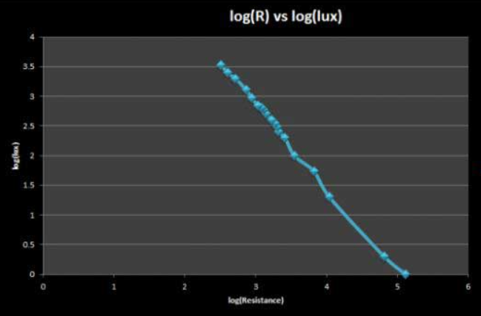

Parameters
Relative light Intensity
Prescription: It’s recommended the screen’s light intensity matches the light intensity from the environment.
Modification: Based on experimentation with our device, we determined an error factor of 75 lx. Setup adapted to that of exp.
Computation:
Read analog value from photoresistor. This measures the voltage drop across the natural resistor connected to it
Convert voltage drop across natural resistor to voltage drop across photoresistor by considering total voltage supplied (5V)
Convert voltage across photoresistor to photoresistance using formula for resistors in series (natural resistor, photoresistor)
Convert photoresistance to light intensity using derived formula from an external experiment with 5V supply and 5kΩ resistor
Notes:
Vaishnavi

Slide 6
Circuit Schematics
Component Terminal | Node MCU Pin
Buzzer (+ve terminal) | D2
Ping Sensor Trigger | D5
Ping Sensor Echo | D6
Photoresistor Analog Pin | A1
GND | GND
To photoresistor
To Arduino GND
To Arduino GND
To Arduino 5V
Five 1 kΩ resistors connected in series
Notes:
Vaishnavi
Ask them if the diagram is clear, otherwise can show it live

Slide 7
Blynk Setup
Smartphone’s built-in light sensor (encircled)
Value display for ambient light intensity measured in lux (lx) by the smartphone’s built-in light sensor
Place your screenshot here
Value display for screen’s light intensity in lux (lx) calculated from voltage drop across photoresistor
Widget | Virtual Pin
Room Light | V1
Screen Light | V2
Segmented Switch | V3
Work Time | V4
Distance | V5
Virtual LCD (Advanced) | V6
1
2
3
4
Value display for elapsed time in one work session in seconds calculated in code
Value display for distance between user and screen measured in cm by Ping sensor
5
Virtual LCD Display to display messages about user’s screen usage
Virtual Switch for user to determine work mode or break mode
6
Notes:
Rachael

Slide 8
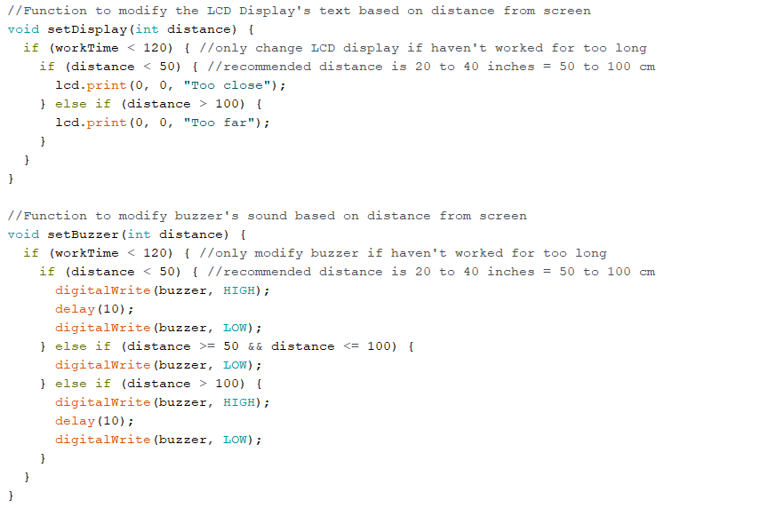
Code
Notes:
Explain why outputs are changed only when workTime is within threshold: because time spent overrides all other conditions
Explain LCD syntax: As per advanced virtual lcd syntax -> lcd.print(x, y, message);
Explain why LCD isn’t cleared here: because this isn’t first function run in each iteration + only uses one row (so that we can see distance display)

Slide 9
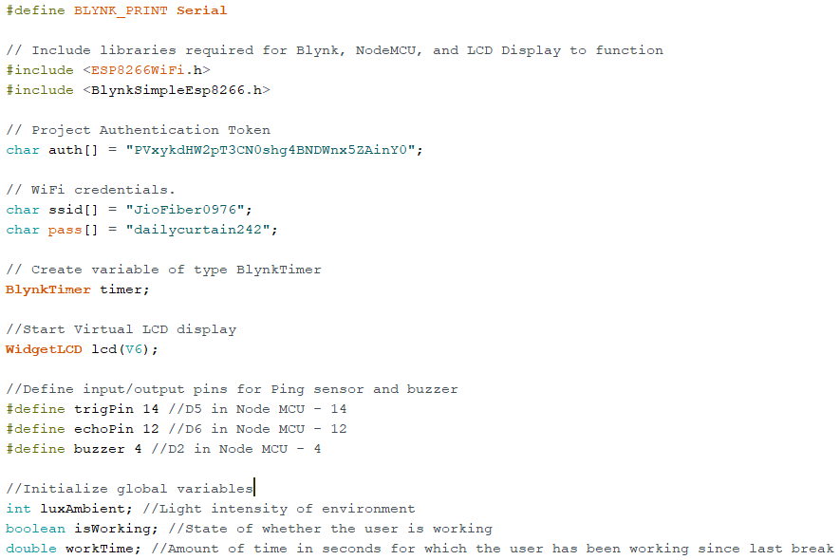
Code
Notes:
Explain why you have global variables (to reference them outside of the scope of their individual functions) - luxAmbient used in setDisp, setBuzz, and myTimerEvent; isWorking used in BLYNK_WRITE(V3) and myTimerEvent; workTime used in setOutput and myTimerEvent

Slide 10
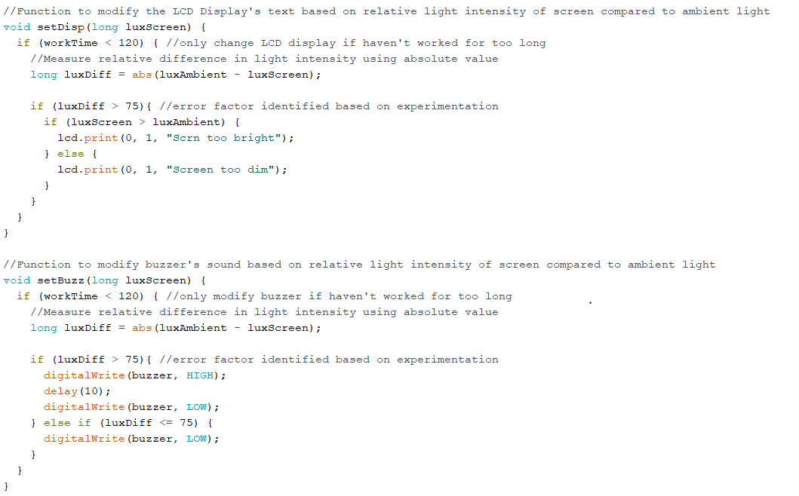
Code
Notes:
Explain why outputs are changed only when workTime is within threshold: because time spent overrides all other conditions
Explain why luxDiff is checked for 75: error factor based on experimenting with phone lux meter and screen (resistors very very sensitive so wider range needed)
Explain why LCD isn’t cleared here: because this isn’t first function run in each iteration + only uses one row (so that we can see distance display)
Explain why messages print screen too dim/bright instead of room too dim/bright: both are possible causes of relative difference, but usually we adapt screen to match environment since that’s easier

Slide 11
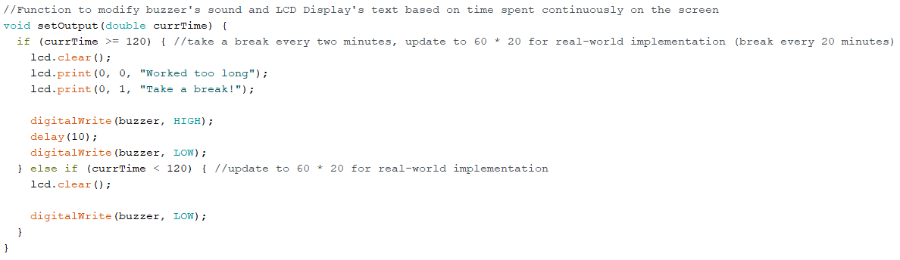
Code
Notes:
Explain why lcd.clear() is run here: because this is first function run in each iteration so clear screen from messages from prev iteration

Slide 12
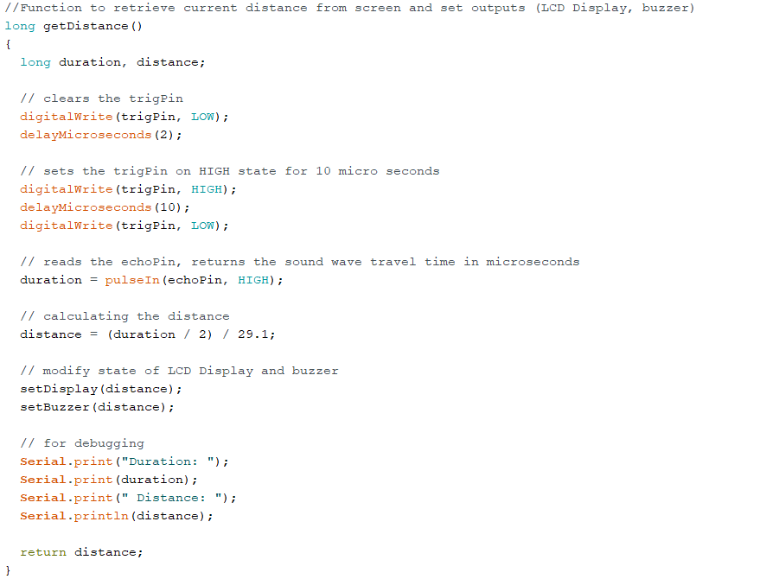
Code
Notes:
Explain full functioning of Ping sensor (sends pulse to trigger for 10 microseconds to start, sends 8 sonic bursts from ping sensor, echoPin receives bursts and then outputs a pulse proportional to distance travelled, convert duration of pulse to distance in cm)
Explain implicit call of functions

Slide 13
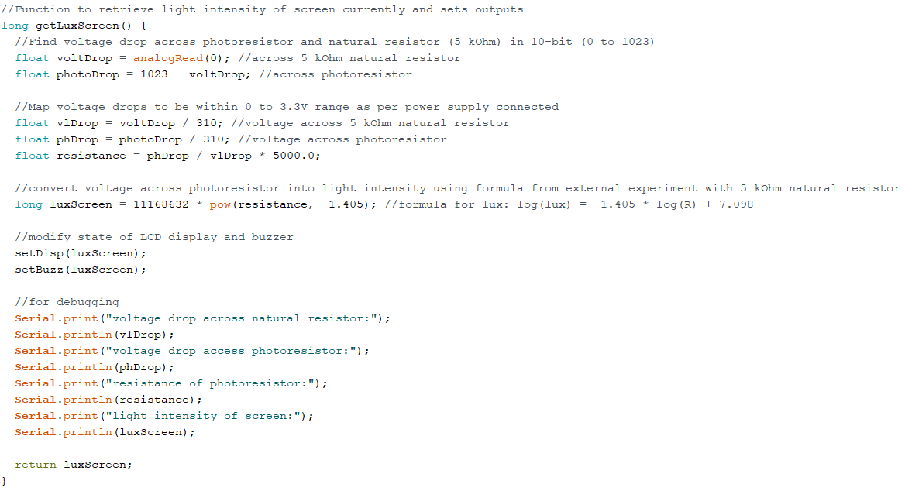
Code
Notes:
Explain computation (as in parameter slide)
Explain how loglux converts to luxScreen

Slide 14
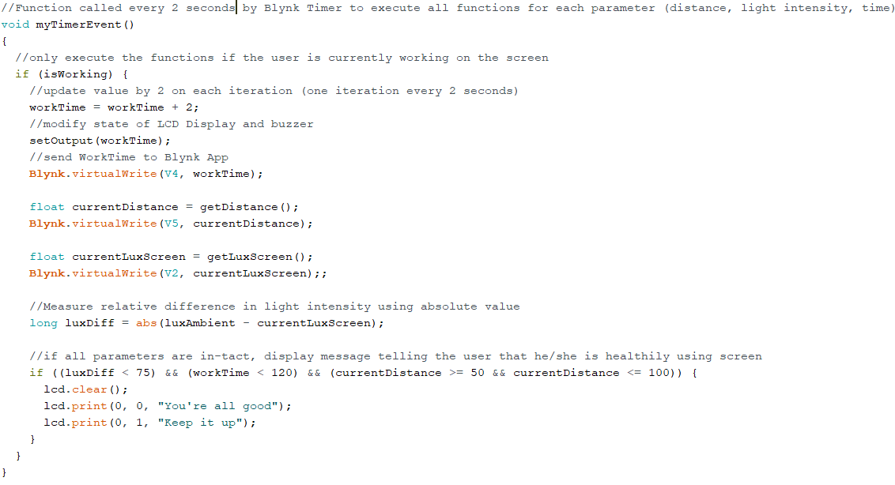
Code
Notes:
Explain why 2 secs was chosen instead of one sec: LCD screen needed sufficient delay time to update message without FLOODING error
Explain the process of sending data to virtual pins
Explain implicit function calls in getDistance & getLuxScreen
Explain why it only should execute when working: no need to take readings when user is on a break
Explain why the you’re all good message only prints if all three parameters in tact: You’re really only good if everything is working

Slide 15
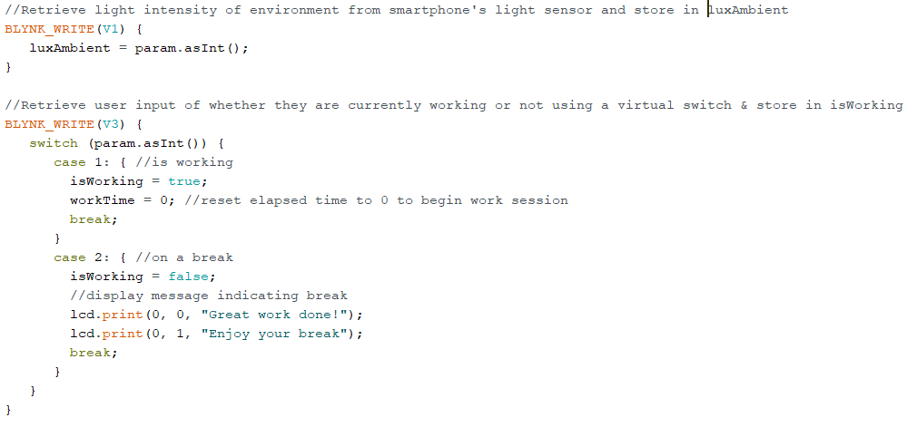
Code
Notes:
Explain how you use global variables to retrieve values coming from user/smartphone (output from Blynk to code)
Explain isWorking as a boolean condition to operate myTimerEvent / just print break message without taking any other readings

Slide 16
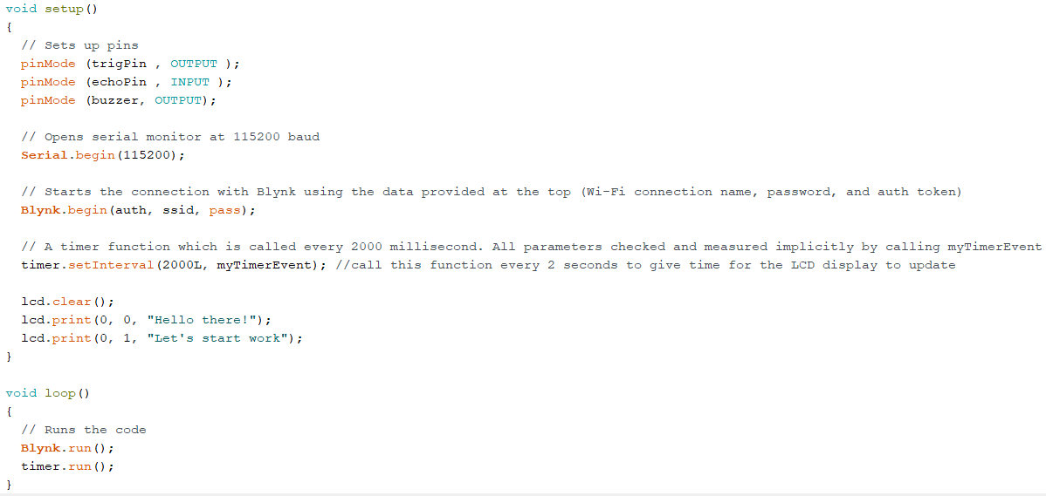
Code
Notes:
Explain why baud rate is 115200: baud rate must match upload speed which is 115200 for node mcu
Explain why buzzer is faint (set to lower volume for sake of hearing)

Slide 17
Challenges and Adjustments
Measuring screen light intensity
Blocking out ambient light
Converting voltage drop to light intensity
Measuring relative light intensity
Limited analog pins on Node MCU
Identifying error factor
Integrating LCD Display into the circuit
Enabling buzzer to function with code
Notes:
Mention that the light intensity prob was so tough we considered switching to a whole new project and worked on two projects concurrently

Slide 18
Implications
Strengths
Measures three key screen-use parameters at once and with priority (screen time > distance and screen time > intensity)
Alerts the user in multiple ways (audio and visual) to ensure they correct their setup
Very user-friendly setup and operation
Ensures productivity and healthy screen usage at once (20 min work sessions ~ Pomodoros)
Applicable to any kind of work using screens: teleworking, online learning, social networking, server monitoring, etc.
Limitations
Design is quite bulky so only suitable for laptops/PCs
Cap is not custom-manufactured so some ambient light can still pass through
Recommended parameters are for adults so not applicable for children/elderly
Direct eye contact is required for accurate reading on Ping sensor
Sensors are fixed to computer screen (not detachable)
Notes:
Racheal

Slide 19
Future Development
Use more compact sensors, breadboard, and microprocessor to suit phone screens
Design a smaller cap using precision tools to more accurately restrict ambient light
Include child and elderly modes into device code with their respective parameters
Use a more advanced sensor to accommodate for an acute viewing angle
Incorporate a clip-on feature to enable sensors to be detachable from the screen
Notes:
Racheal

Slide 20
Bibliography
https://www.digikey.com/en/maker/projects/design-a-luxmeter-with-an-ldr-and-an-arduino/623aeee0f93e427bb57e02c4592567d1
https://www.wired.com/2013/09/flux-eyestrain/
https://www.osha.gov/SLTC/etools/computerworkstations/components_monitors.htm
https://www.healthline.com/health/eye-health/20-20-20-rule#symptoms
https://invootech.blogspot.com/2017/06/how-to-convert-ldr-dependent-resistor.html

Slide 21


Thanks!
Any questions?

